Slide 1

Intro to the University of Iowa Utility Data System
University of Iowa Data Science Organization
October 26, 2023

Slide 2


Slide 3
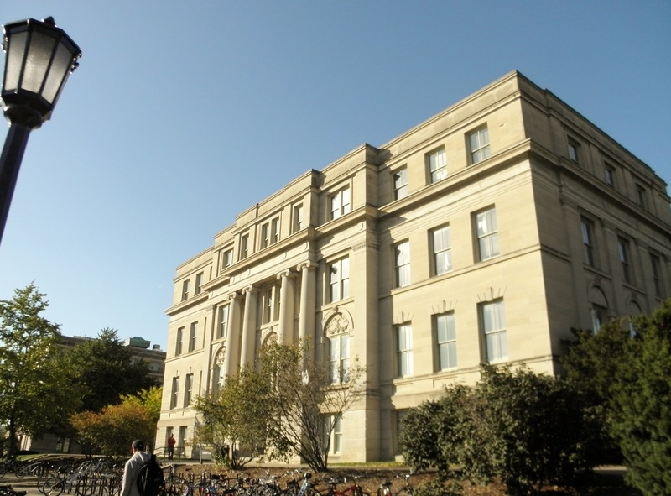




Building Utilities
Schaeffer Hall
Utilities
Electricity: Uses electricity from the UIowa electric grid
Steam: Heats the building with steam from the UIowa steam system
Chilled Water: Cools the building with chilled water from the UIowa chilled water system
Potable Water: Serves drinking water from the UIowa water system

Slide 4
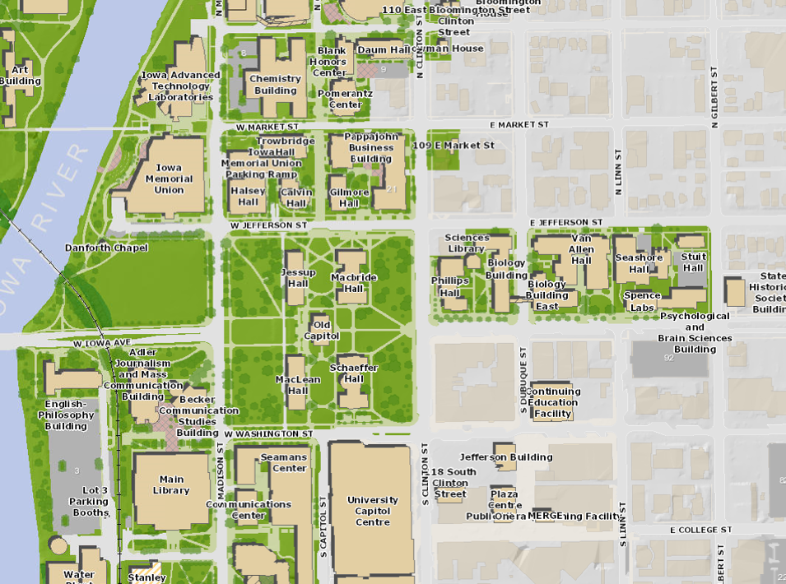
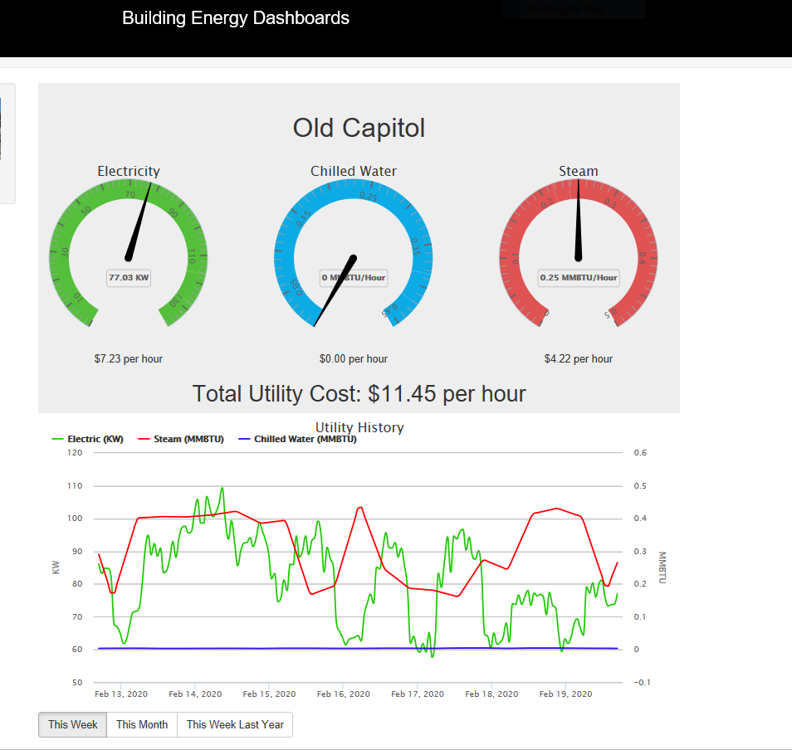
Utility Billing
The UIowa utility system bills buildings for their energy and water usage similar to a regular utility company

Slide 5
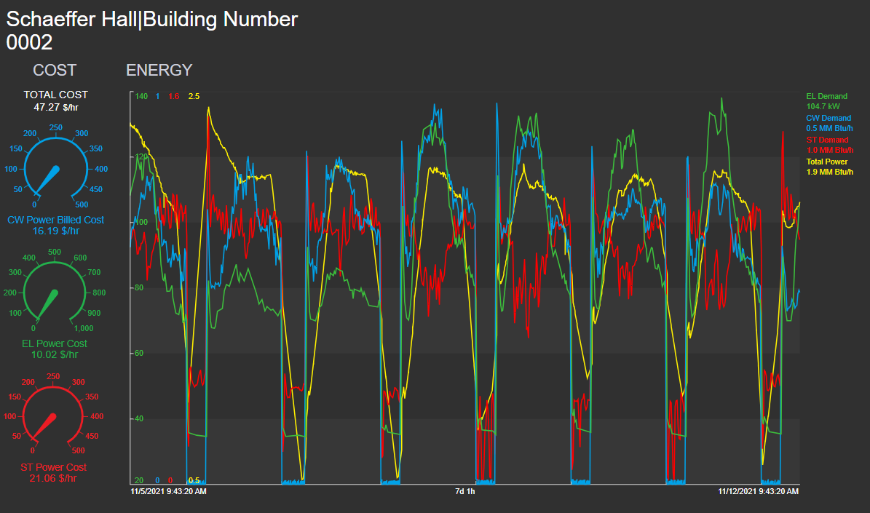
Utility Billing

Slide 6
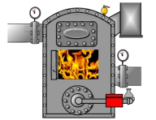
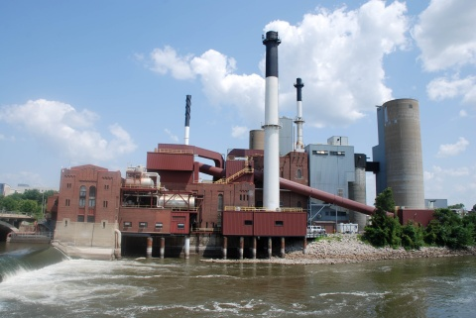

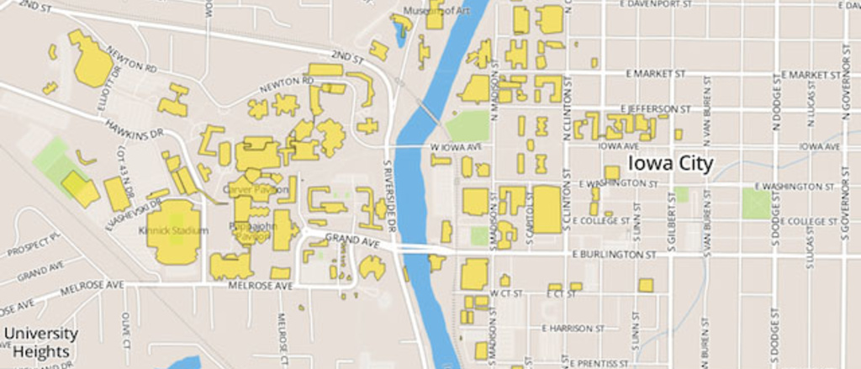

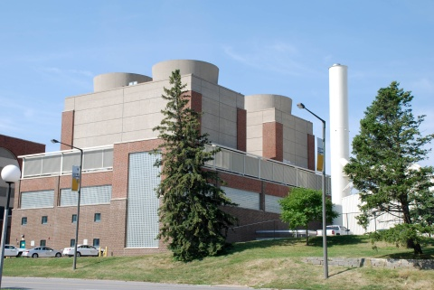
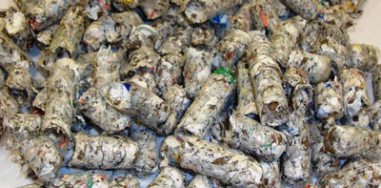
Steam Generation
The power plant houses 5 boilers to produce steam. 3 burn natural gas and 2 burn energy pellets (pre-consumer papers and plastics)
The system can also generate steam from two remote boilers: one located in the hospital and the other on the west side of campus. Both remote boilers burn natural gas.

Slide 7
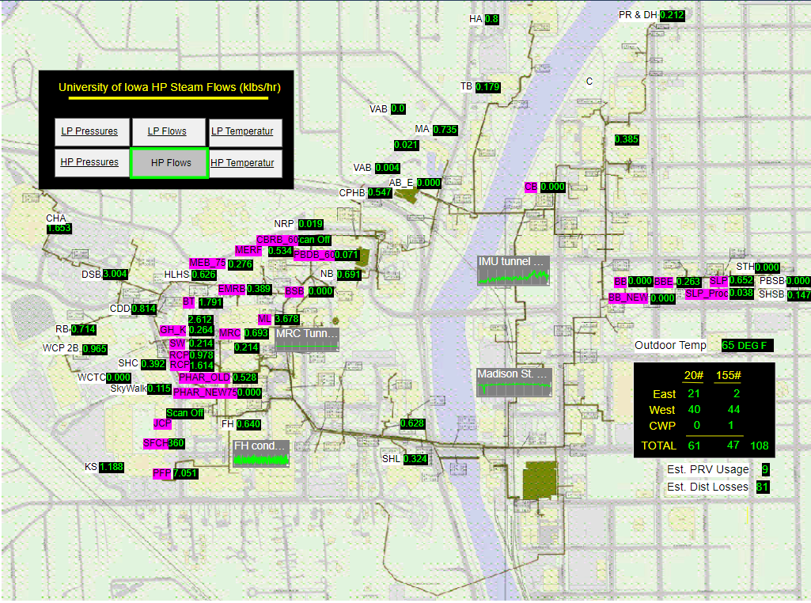
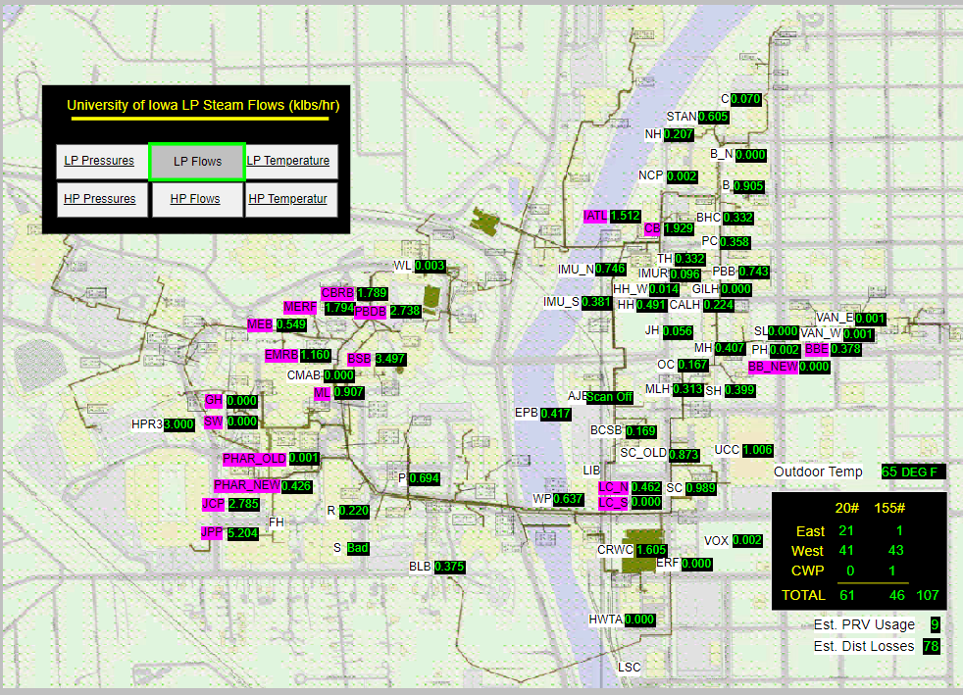
Steam Distribution Grid
The system distributes steam across campus at two pressures: 150 PSI and 20 PSI

Slide 8
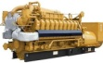
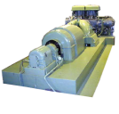
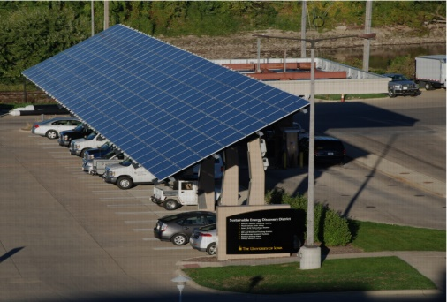
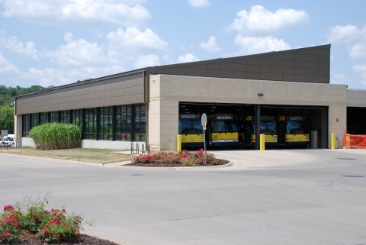
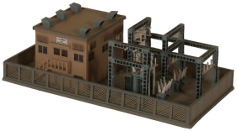

Electric Generation
The power plant houses 3 steam turbines and 4 natural gas generators to produce electricity.
The utility system also purchases electricity from MidAmerican Energy Company.
System has two solar arrays in the Renewable Energy Discovery District.

Slide 9
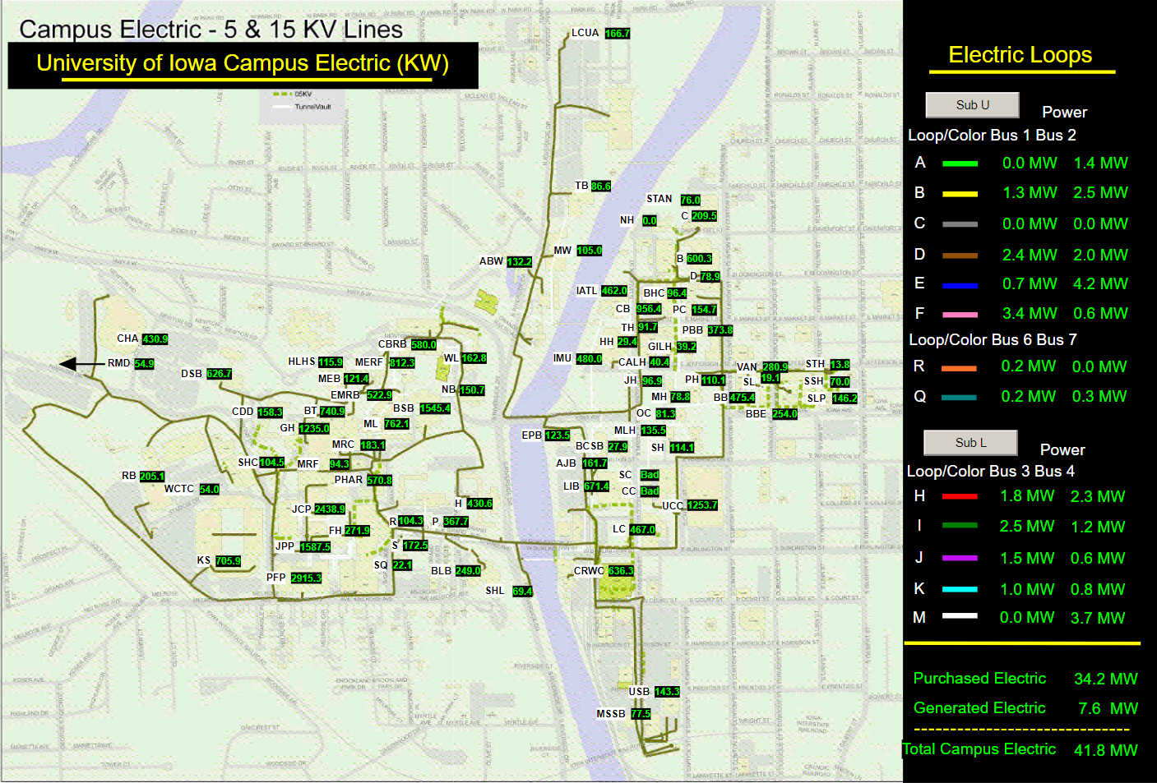
Electric Distribution Grid

Slide 10
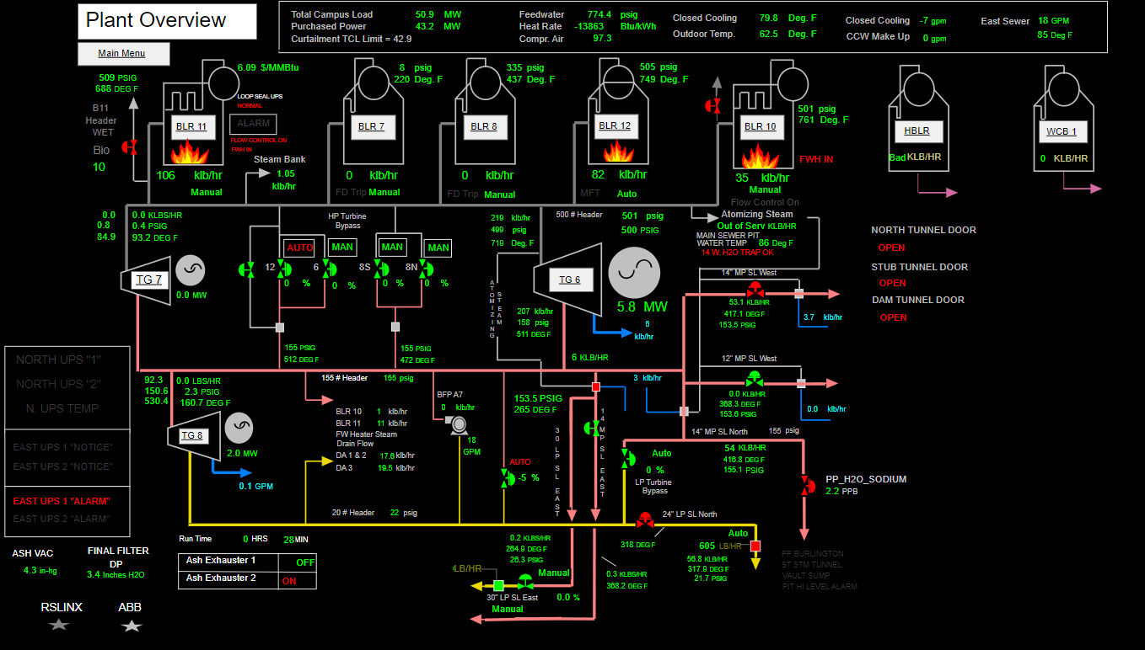
Power Plant Overview

Slide 11
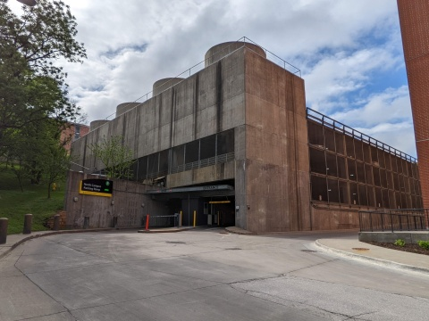
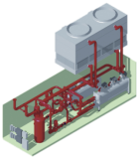
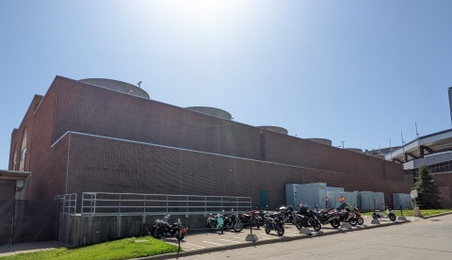
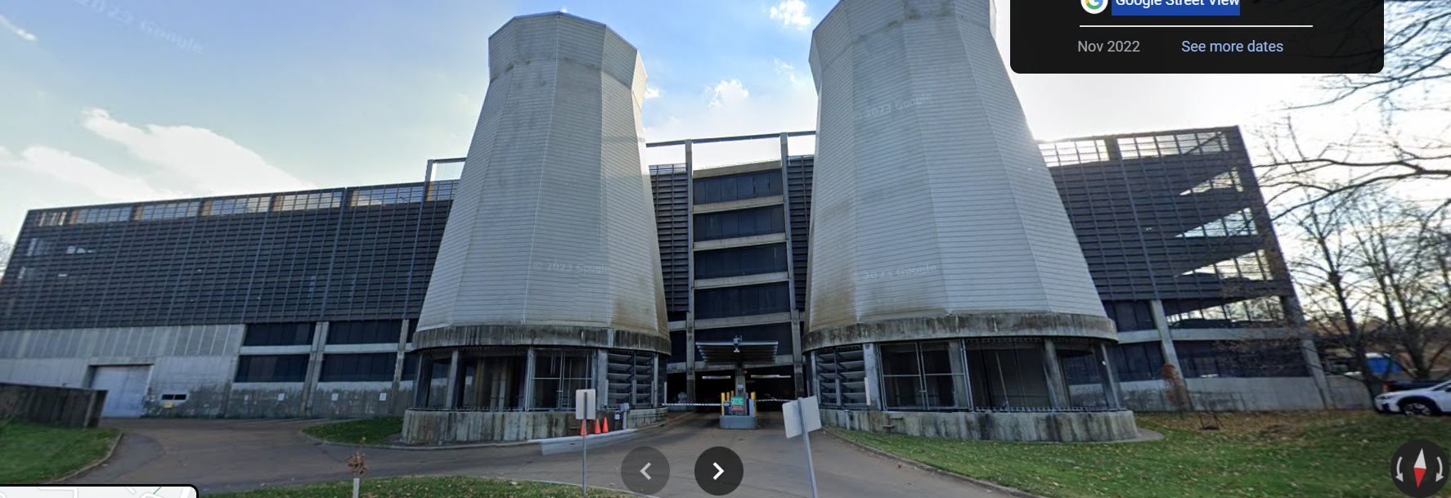
Chilled Water Generation
3 chilled water plants housing 16

Slide 12
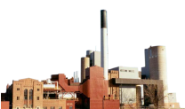

University of Iowa Main Campus Utilities
Substation U
161 kV
Substation L
69 kV
West Campus
East Campus
Power Distribution West
Across Campus Tie (N/O)
Power Distribution East
Water Treatment Plant
Potable Water Distribution
West
Potable Water Distribution
East
Main Power Plant
Natural Gas Engine Electric Generators
Steam Turbine Electric Generators
NG
Boilers
Natural Gas Boilers
Solid Fuel Boilers
NGB
WCB
UIHC
7
8
10
11
12
Steam Distribution West
Steam Distribution East
West Chiller Plant
Northwest Plant
North Chiller Plant
Steam Chillers (3)
Steam Chiller (1)
Steam Chillers (3)
Electric Chillers (8)
Electric Chillers (1)
Chilled Water Distribution
West
Chilled Water Distribution East
Legend: Electrical Chilled Water
Steam Potable Water

Slide 13
Data/Coding Exercise
Exercise: Get the hourly energy usage of Schaeffer Hall over the past 5 (or so) years.
Important Notes:
Energy is served in three forms: electric, steam, and chilled water
Data is recorded in units of power (a unit of energy over a unit of time)
Power | Energy
Kilowatts (kilojoules per seconds) | Kilowatt-hours (3600 kilojoules)
MMBTUs per hour | Metric Million British Thermal Unit (MMBTU)
MMBTUs per hour | Metric Million British Thermal Unit (MMBTU)
Discoveries to make:
What day/hour was the highest energy usage for each resource
What day/hour was the highest total energy usage (all resources combined)
?

Slide 14
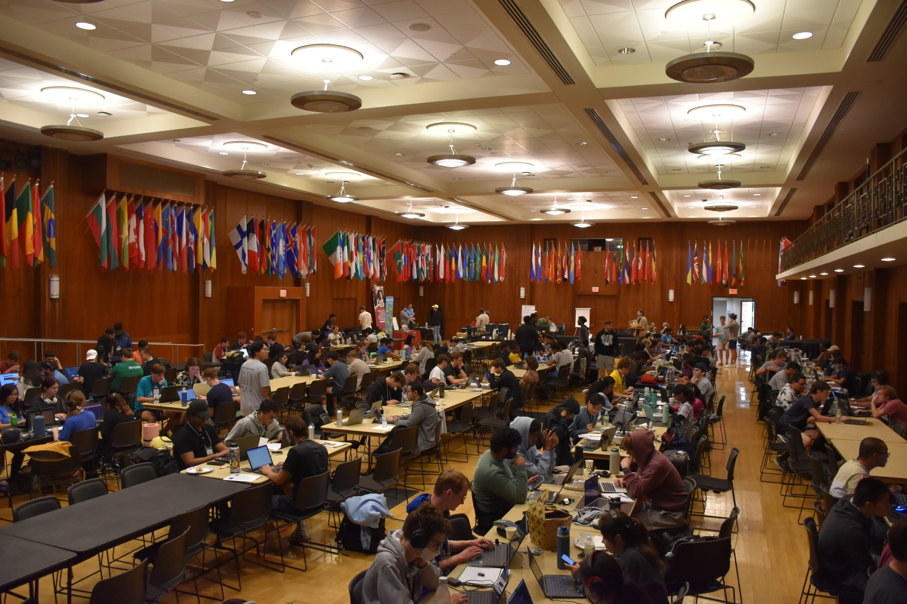
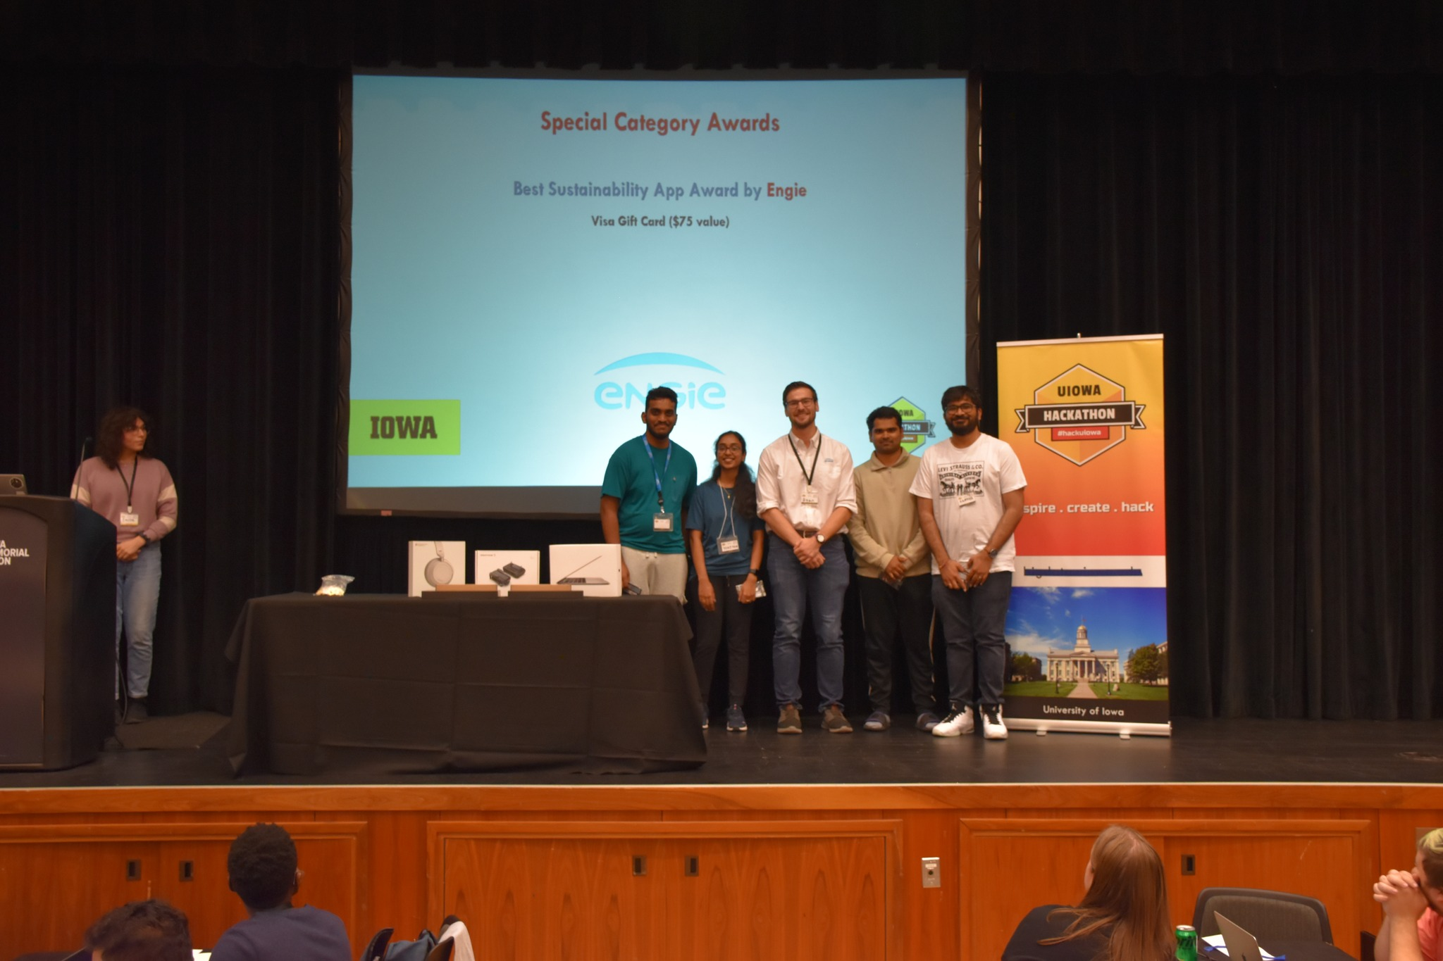
UIowa Hackathon Solar Performance Challenge

Slide 15
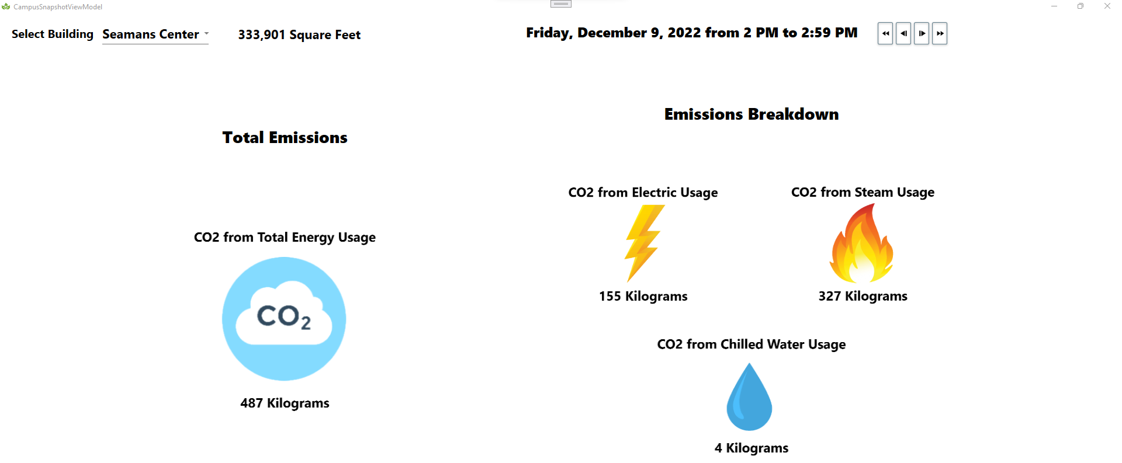

Slide 16


Modeling Layer
f
f
f
f
f
f
f
f
f
f
f
f
f
f
f
f
f
f
f
f

Slide 17
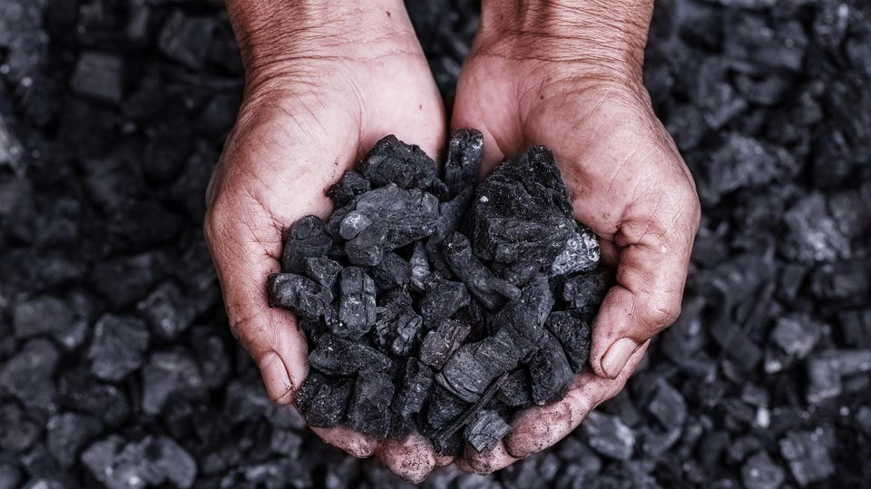
No Coal by 2025
Fuel Comparison
Coal
Energy Pellets
1.02 Kg-CO2 per pound burned
10,940 BTUs per pound
$0.041 per pound
Details: Bituminous
0.61 Kg-CO2 per pound burned
9,529 BTUs per pound
$0.048 per pound
Details: %57.5 Biomass, %42.5 Pre-Consumer Plastics

Slide 18
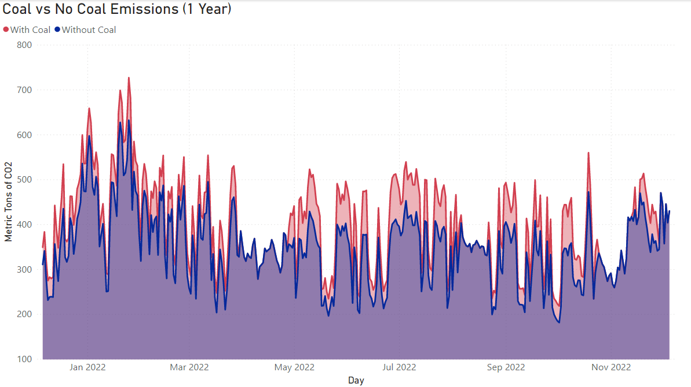
Replacing Coal with Energy Pellets
18,220 Metric Tons of CO2 Prevented! (%12.5 decrease)

Slide 19
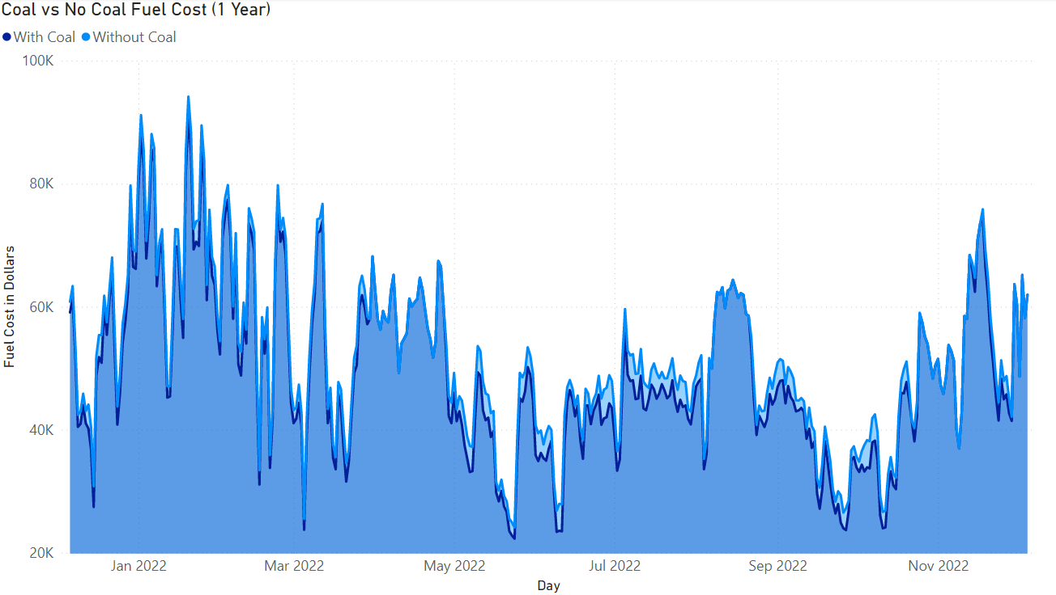
Replacing Coal with Energy Pellets
$827,549 more in Fuel Costs (4.4 percent increase)

Slide 20
Questions and Contacts
Questions?
Contacts:
Ryan Policheri, Senior Software Developer: ryan.policheri@engie.com
Wylan Gao, Energy Data Center Intern: wylan.gao@engie.com

